Slide 1
Cryptography
Hash Function
CSC 481/681/781
Principles of Computer Security

Slide 2
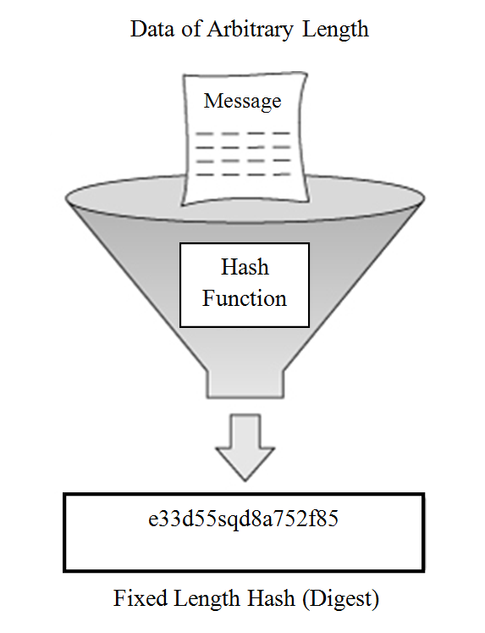

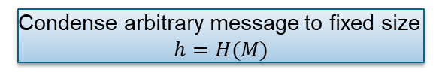
Hash Functions
Hash Functions: a hash function $h$ maps each finite-length string $x$ to an element $h(x)$ of some range $Y$. (e.g., $Y{=\{0, 1\}}^{256}$)
– length of $x$ can be as long as you want
The hash value represents concisely the longer message
- may called the message digest;
A message digest is as a ‘digital fingerprint’ of the original document.
Condense arbitrary message to fixed size
$$h=H(M)$$

Slide 3
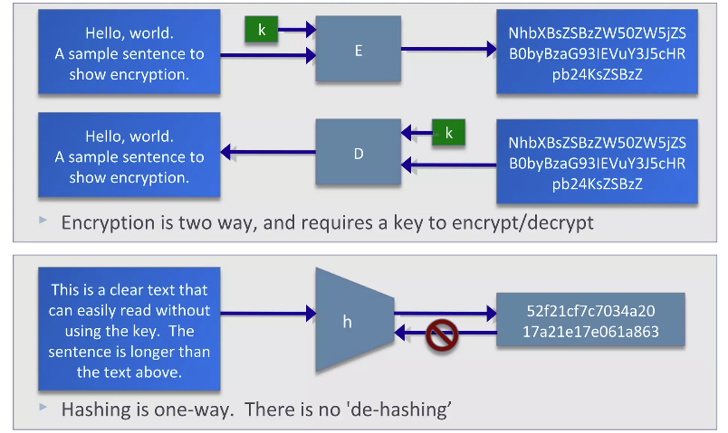
Hash Functions
Hashing V.S. Encryption

Slide 4
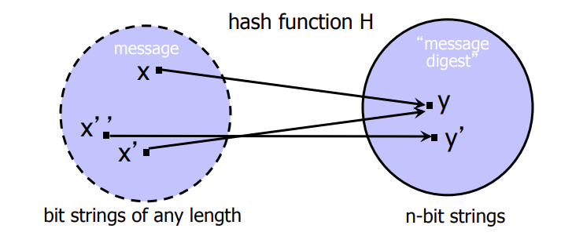

Hash Functions
Hash Collisions: no matter what $h$ is, will have collisions.
- collision: pair $x≠x′$ for which $f\left(x\right)=f(x′)$

Slide 5

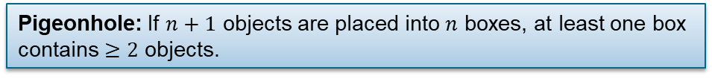
Hash Functions
Hash Collisions: no matter what $h$ is, will have collisions.
- collision: pair $x≠x′$ for which $f\left(x\right)=f(x′)$
Pigeonhole: If $n+1$ objects are placed into $n$ boxes, at least one box contains $≥2$ objects.

Slide 6
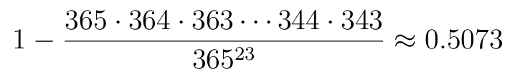
Hash Functions
Hash Collisions: no matter what $h$ is, will have collisions.
- collision: pair $x≠x′$ for which $f\left(x\right)=f(x′)$
Birthday Paradox: There are n=23 people in a room, with random birthdays. What is the probability that two have the same birthday? Surely with d=365 possibilities (ignoring leap years!) the odds are low, right?
Wrong! Probability is
Better than a 50/50 chance of a duplicate birthday!

Slide 7

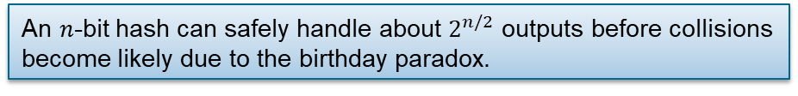
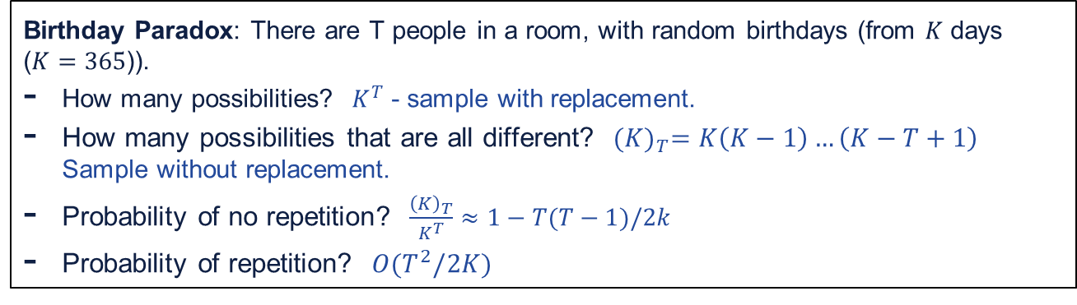
Hash Functions
Hash Collisions: no matter what $h$ is, will have collisions.
- collision: pair $x≠x′$ for which $f\left(x\right)=f(x′)$
Birthday Paradox: There are T people in a room, with random birthdays (from $K$ days ($K=365$)).
How many possibilities? $K^{T}$ - sample with replacement.
How many possibilities that are all different? ${(K)}_{T}=K\left(K−1\right)…\left(K−T+1\right)$ Sample without replacement.
Probability of no repetition? $\frac{{\left(K\right)}_{T}}{K^{T}}≈1−T(T−1)/2k$
Probability of repetition? $O(T^{2}/2K)$
An $n$-bit hash can safely handle about $2^{n/2}$ outputs before collisions become likely due to the birthday paradox.

Slide 8
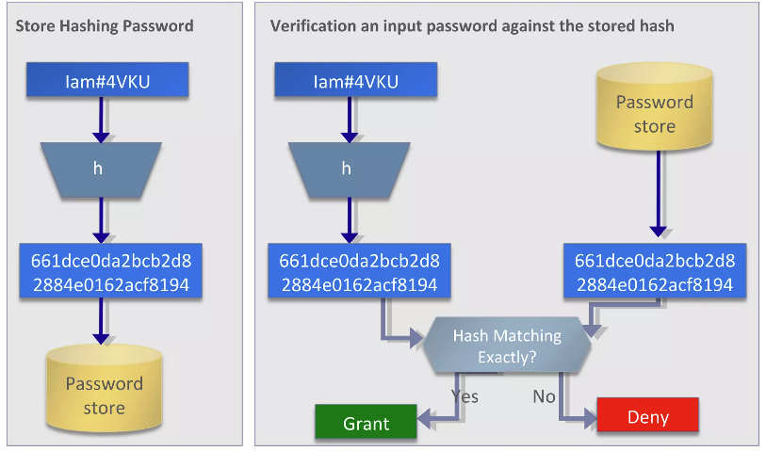
Application: Password Hashing
System does not store actual passwords! Cannot go from hash to password!

Slide 9
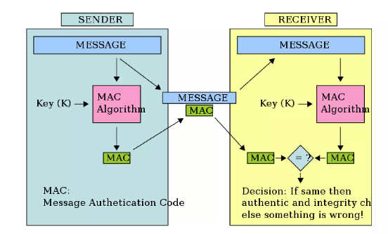
Application: Message Authentication Code (MAC)

Slide 10
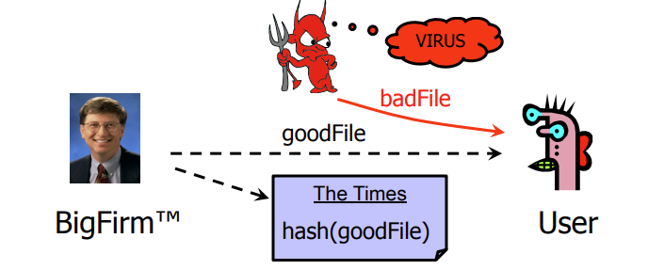
Application: Message Authentication Code (MAC)
Software manufacturer wants to ensure that the executable file is received by users without modification…
Sends out the file to users and publishes its hash in the NY Times
The goal is integrity, not secrecy
Idea: given goodFile and hash(goodFile), very hard to find badFile such that hash(goodFile)=hash(badFile)

Slide 11
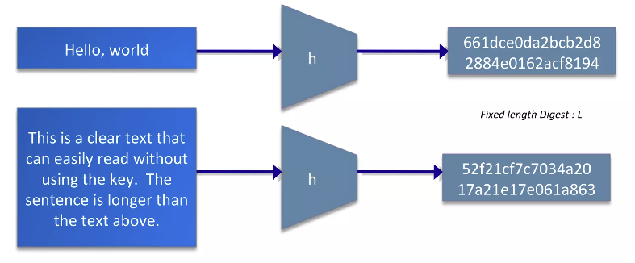
Hash Function Properties
Arbitrary-length message to fixed-length digest

Slide 12
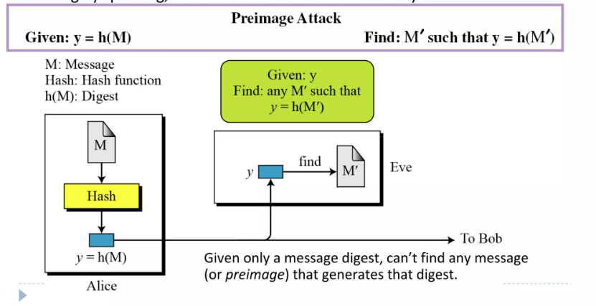
Hash Function Properties
Preimage resistant: This measures how difficult to devise a message which hashes to the known digest
Roughly speaking, the hash function must be one-way.

Slide 13
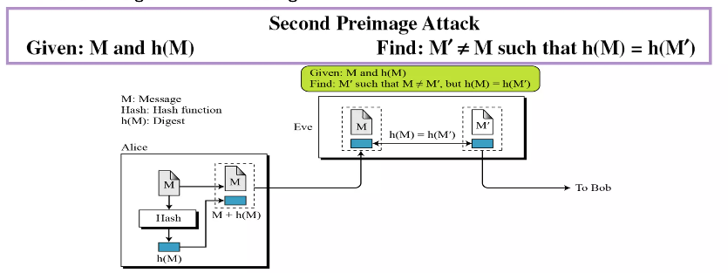
Hash Function Properties
Second Preimage resistant: This measures how difficult to devise a message which hashes to the known digest and its message.
One-target attack
Given one message, can't find another message that has the same message digest. An attack that finds a second message with the same message digest is a second pre-image attack.
lt would be easy to forge new digital signatures from old signatures if the hash function used weren't second preimage resistant.

Slide 14
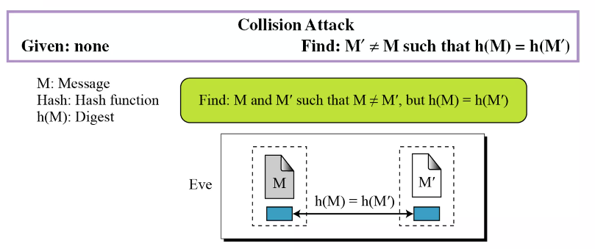
Hash Function Properties
Collision Resistant
Free-choice attack
Can't find any two different messages with the same message digest;
Collision resistance implies second preimage resistance;
Collisions, if we could find them, would give signatories a way to repudiate their signatures.

Slide 15
Hash Function Properties
Collision Resistant
Can't find any two different messages with the same message digest;
Collision resistance implies second preimage resistance;
Collisions, if we could find them, would give signatories a way to repudiate their signatures.

Slide 16
Test your understanding…
Q1. Can we use a conventional lossless compression method (e.g., ZIP) as a cryptographic hash function?
Q2. A hash function outputs 128 bits. Approximately how many random inputs can we hash before collisions become likely?
Q3. Does preimage resistance imply collision resistance? Why or why not?
Q4. Suppose H(x)=x mod 1000. Which hash security properties does this function fail?

